Slide 1
What’s new in WinForms

Slide 2
A little history lesson
WinForms is a managed wrapper around Win32 and Common Controls
WinForms was born 2002 with Visual Studio .NET/.NET Framework 1.0
.NET Framework 2.0 added Panels, *Strips, DataGridView
.NET Framework 4.0-4.8.1 saw continuing investments in Display scaling, accessibility, etc.
To this day, it’s the backbone of many enterprise apps
2019 we open-sourced WinForms with .NET Core 3.0
Notes:
Windows Forms was introduced in 2002 with the original Visual Studio .NET
.NET Framework 2.0 added Layout Panels, ToolStrips and DataGridView DesignerAction Panels Databinding engine, Designer features
* .NET Framework 4.0 added Chart Control
* .NET Framework 4.6-4.7 increased compatibility for HighDPI, and completed SystemAware. It also introduced events for DPI-changes in PMV2 scenarios.
4.8.1 added ARM64 support and tons of accessibility.
Open Sourced for .NET Core 3.0 in 2019
* Full support for Application Framework for VB with .NET 6.

Slide 3
WinForms in .NET
Community driven features
Improved rendering performance
Modernizing COM/Interop
Improving look/feel
Accessibility improvements
Full support for VB Application Framework in .NET 6
New data binding features
https://github.com/dotnet/winforms
Notes:
.NET Can change and evolve in a way that .NET Framework cannot. .NET Framework is inbox and .NET is not

Slide 4

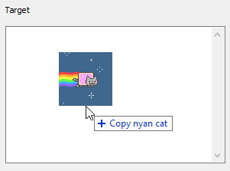
Improving the look and feel
Modern FolderBrowserDialog
New Default Font
Drag/Drop Previews
SystemAware by default
Better scaling support
Rounded corners and Snap Layouts
Access to modern system icons

Slide 5
Demo
A whirlwind of new stuff since WinForms went Open Source

Slide 6
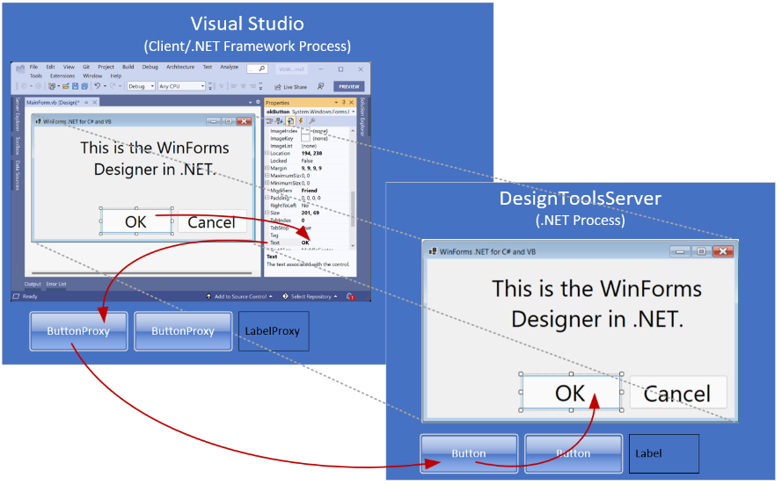
Visual Studio Experience
Visual Studio needs to run InitializeComponent() method to display your form
.NET Framework WinForms apps run in the VS process
.NET apps design in a separate process (DesignToolsServer.exe)
New extensibility model for writing design experiences for your controls
Notes:
WinForms can never be really separated from the design experience!
Resource links at the end of the slide

Slide 7
DPI unaware designing
Coordinates and sizes are serialized based on the current display settings
Causes both design-time and runtime issues
Restarting VS in DPI-Unaware was the only solution
DPI-Unaware Tab is introduced in 17.8

Slide 8
Demo
DPI Unaware Designing

Slide 9
Command Binding in WinForms .NET
More than 25 new APIs for DataBinding in .NET 7:
BindableComponent
DataContext
Command
CommandParameter
New DataBinding Events
Made all ToolStripItems bindable
Preview for .NET 7, enabled by default in .NET 8

Slide 10
CommandBinding in WinForms .NET 8
WinForms Components were always highly customizable, but never bindable. Like this custom menu item:
In .NET 8, if you have a ViewModel like for WPF, WinUI or .NET Maui…
…not only can you now bind ViewModel properties to Components…
…you can also create Commands in your ViewModel for binding.
And for .NET 9, we will be introducing Converters – WinForms style!
Notes:
WinForms UI Elements were never only controls. ToolStripItems are components, and they were always highly customizable. But they were also never bindable. Until now. What you see here is one example: It’s the custom implementation of a ToolStripDropDownButton, and instead of Bitmaps, it uses the modern, fluent-UI style Symbol Font of Windows 11 as it’s icon source. Since those Symbols are vector graphics, they look crisp in any size, are perfect for HighDPI scenarios and super-easy to set up: Because the OOP-Designer automatically picks up the Design-Time functionality.
With .NET 8, that changes – components become bindable. And with that, ToolStripItems, (which are Components), also become bindable. That opens the World of ViewModels for WinForms, and you can use the Community Toolkit to create ViewModels as DataSources, which you can easily hook up with the new WinForms Add Object DataSource dialog. And once you added the DataSources, your using the existing WinForms DesignBindingPicker to hook up the bindings – the same way you did it for decades with the binding of controls.
But .NET 8 brings more: .NET 8 introduces Command Binding for WinForms. Every Button in WinForms gets a Command and a CommandParameters property. And the same is true for every ToolStripItems. And with that, WinForms can bind to the automatically generated Relay Commands of a Community Toolkit ViewModel, as WPF, WinUI or .NET Maui does. (And that also means, that you can use existing ViewModel logic also for your WinForms Apps. Or use this new Feature in modernization scenarios: Move your code-behin approach to a ViewModel-base architecture, and reuse the ViewModels for Maui Apps, where it makes sense.
And to bring WinForms yet a step further to full ViewModel binding support, here is a little Preview of an early .NET 9 implementation: Write your own ComponentModel based TypeConverters, and then use them directly in the WinForms Designer to adapt existing ViewModels to the WinForms User Interface specifics.

Slide 11
Accessibility
WinForms originally used MSAA (Microsoft Active Accessibility)
Windows has moved on to UIA (UI Automation)
Tools from Narrator and NVDA to eye tracking software depend on UIA patterns
Accessible by default is our goal
Recommend using Accessibility Insights for Windows
Notes:
MSAA – 1997. Lots has changed
UIA was Vista – added lots of patterns

Slide 12
Demo
Accessibility Insights for Windows

Slide 13
Tell us about your migration
aka.ms/WinFormsFeedback

Slide 14


Resources
Download .NET 8 aka.ms/get-dotnet-8
WinForms Runtime Repo https://github.com/dotnet/winforms
Updated Docs Windows Forms for .NET | Microsoft Learn
Accessibilty Insights Accessibility Insights for Windows

Slide 15
Resources
Creating controls with WinForms for .NET https://learn.microsoft.com/en-us/dotnet/desktop/winforms/controls/overview
Extensibility samples microsoft/winforms-designer-extensibility (github.com)
CommandBinding Blog https://devblogs.microsoft.com/dotnet/winforms-cross-platform-dotnet-maui-command-binding/

Slide 16
Download .NET 8
https://aka.ms/get-dotnet-8

